Slide 1
Decentralized finance application using blockchain technology
19BD1A05C3 | AKSHAYA CHANCHALA
19BD1A05C4 | A. PEARL PRIYANKA
19BD1A05CD | CH. ASVITHA REDDY
19BD1A05DL | S. RAHUL

Slide 2
OUTLINE OF THE PRESENTATION
introduction
Literature survey
TECHNOLOGIES USED TO DEVELOP THE APP
UML Diagrams
implementation

Slide 3
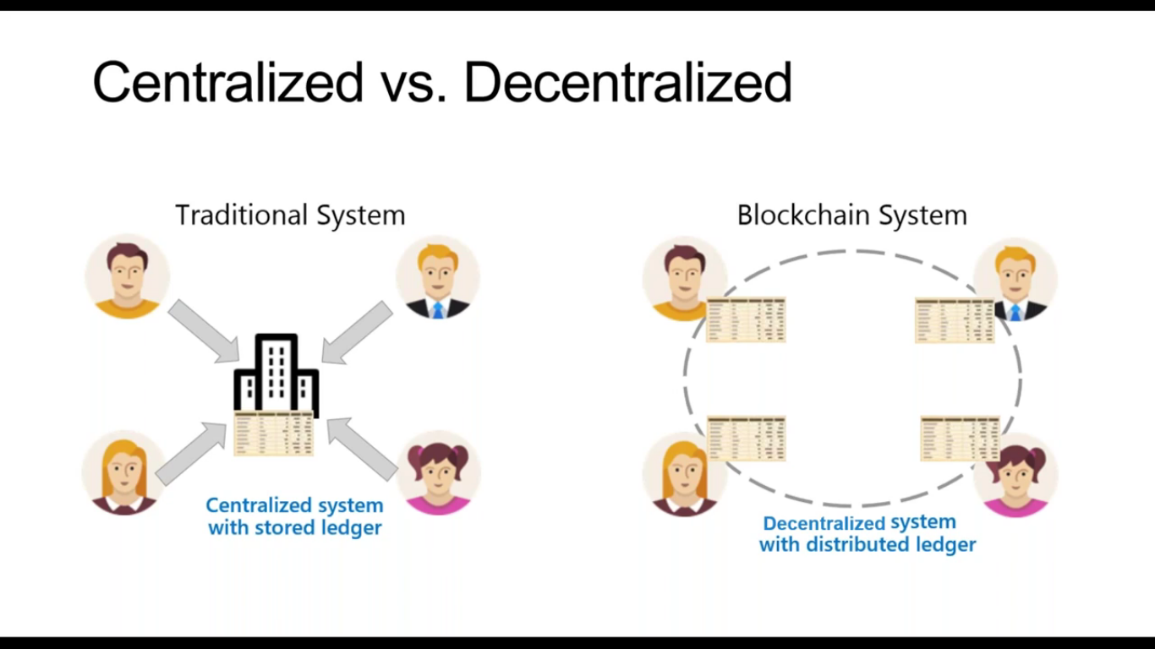
INTRODUCTION
Blockchain
It is a shared, distributed and permanent database that is shared among multiple nodes in a computer network.
They record data in such a way that it makes it almost impossible to modify or hack the system.
Blockchains also play a crucial role in cryptocurrency systems, such as Bitcoin, for maintaining a secure and decentralized record of transactions. The goal of blockchain is to allow digital information to be recorded and distributed, but not edited.

Slide 4
DECENTRALIZED FINANCE
What is Decentralized Finance?
DeFi (or “decentralized finance”) is an umbrella term for financial services on public blockchains, primarily Ethereum.
With DeFi, you can do most of the things that banks support — earn interest, borrow, lend, buy insurance , trade derivatives, trade assets, and more — but it’s faster and doesn’t require paperwork or a third party.
Need of Decentralized Finance :
DeFi takes the basic premise of Bitcoin — digital money — and expands on it, creating an entire digital alternative to Wall Street, but without all the associated costs.
This has the potential to create more open, free, and fair financial markets that are accessible to anyone with an internet connection.

Slide 5
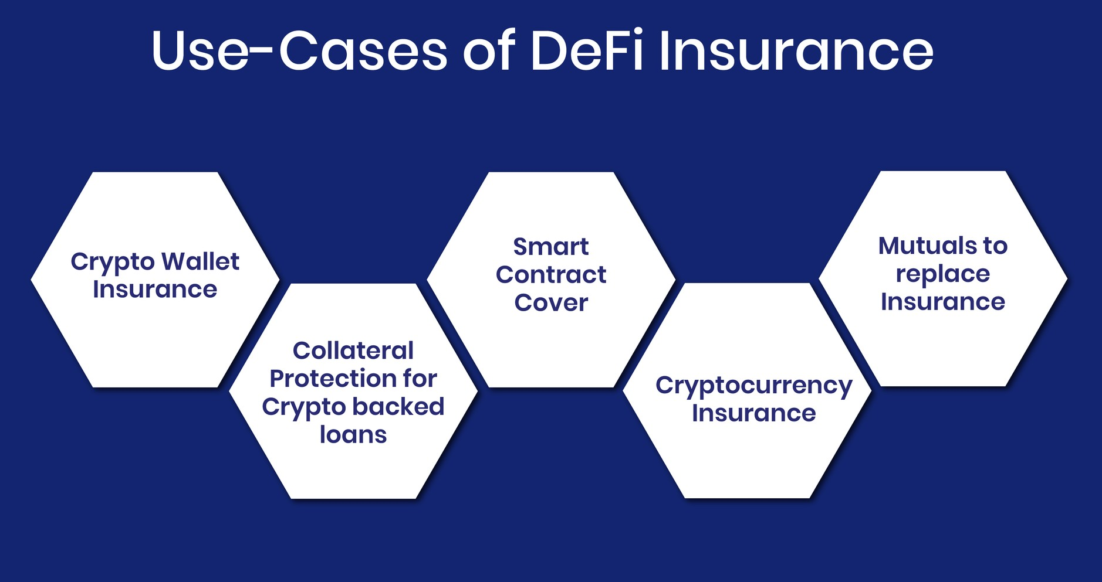
Need of Decentralized Finance :
Decentralized applications (also known as “DApps”) provide services similar to those offered by typical consumer applications, but they use blockchain technology to grant users more control over their data by eliminating the need for centralized intermediaries to manage the data, thus making the service “decentralized”.

Slide 6
Purpose of Project
Decentralized finance applications are designed to overcome these risks by distributing power and control among a network of users.
This can provide a number of benefits, such as increased security, resilience, and transparency.
The need for decentralized finance applications arises from the fact that traditional financial institutions are centralized. This means that they are subject to the risks associated with centralization, such as single points of failure and the potential for corruption.

Slide 7
Problems with Existing System
When it comes to cryptocurrency exchanges, there are mainly two types of exchanges, centralized exchange and decentralized exchange.
Centralized crypto exchanges that act as a middleman between the buyer and the seller and make money through commissions and transaction fees. Popular CE service providers are Finance, Coinbase etc.
To explain the drawbacks of the existing system we will be considering that we experience in real life. We will be comparing how exchange at centralized authorities say airports or banks work.

Slide 8
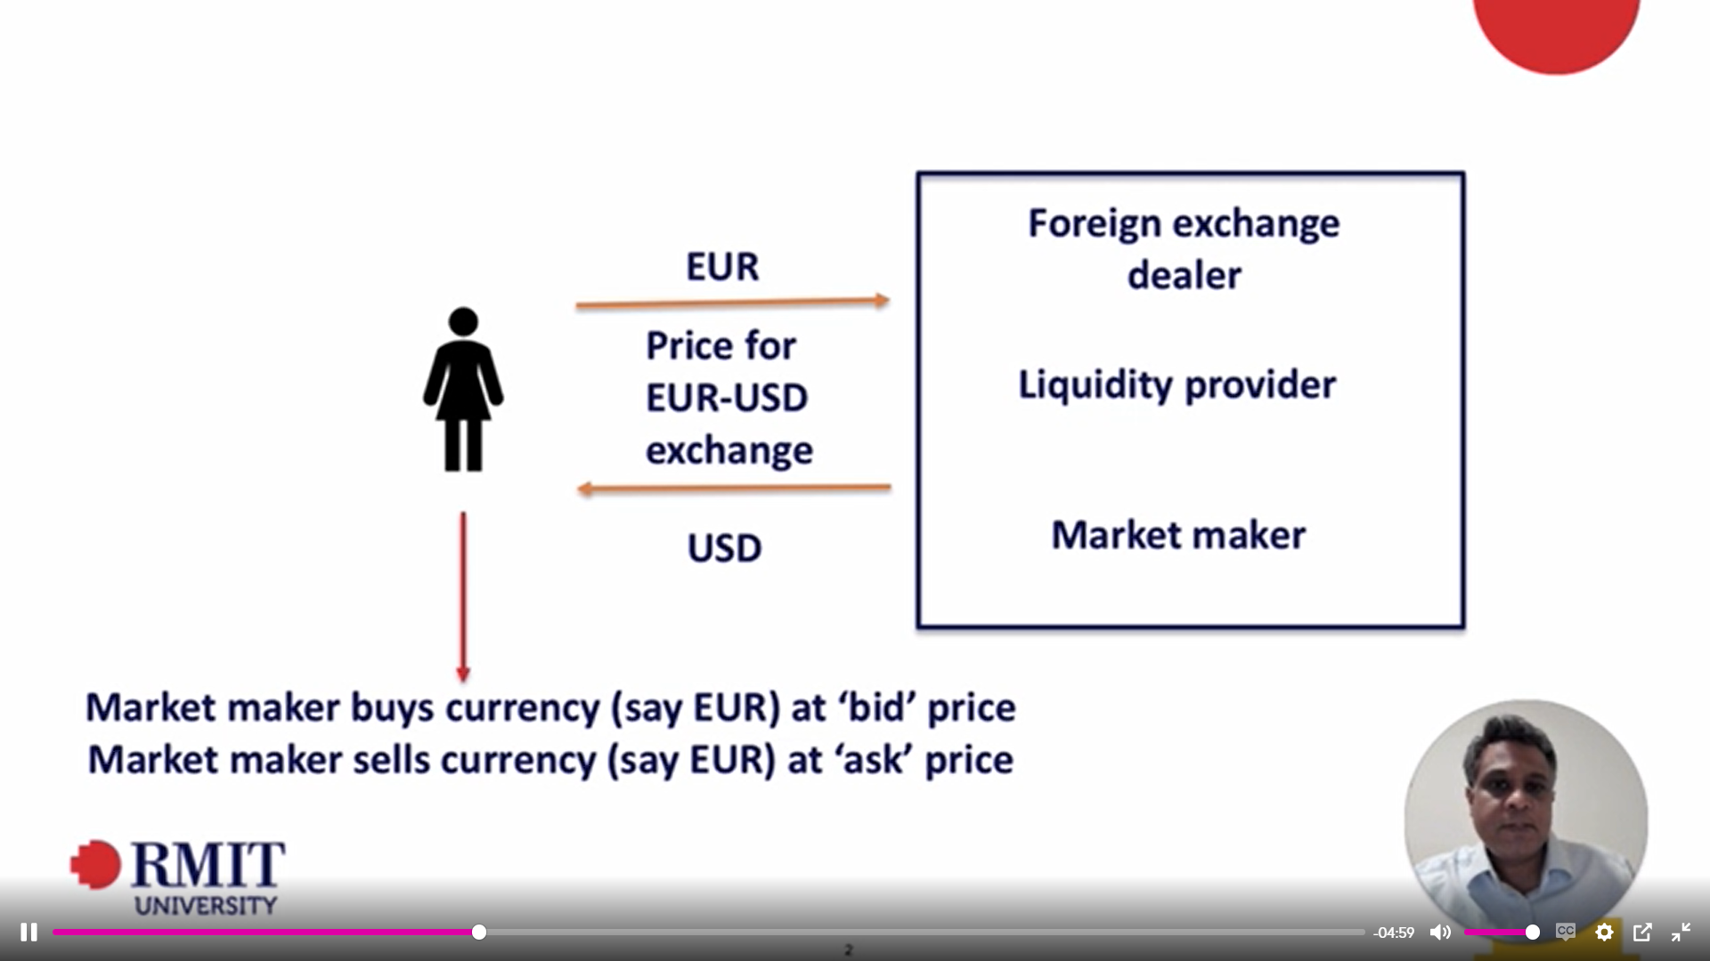
This image shows how a centralized exchange system works

Slide 9
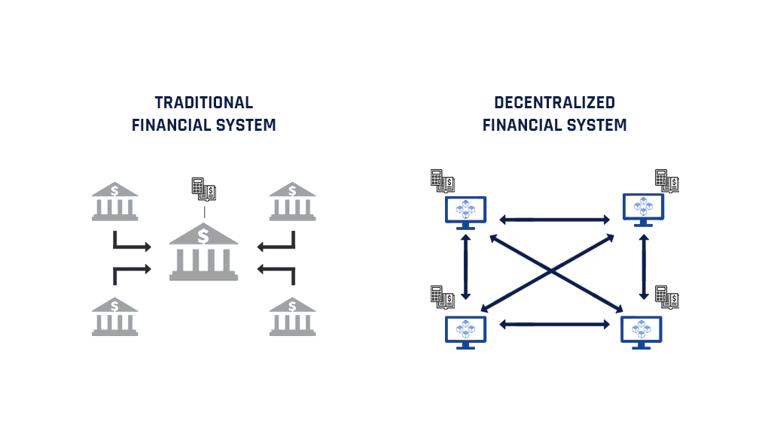
Proposed System
The main idea behind the proposed system is to allow users to exchange one form of crypto currency to another and allows a decentralized form of exchange without any authority present.
CREX is designed to be as user friendly as possible, with a simple interface that allows users to easily swap between tokens. There is no need to set up an account or login, and the process is designed to be as seamless as possible.
This image depicts how the decentralized system works
This image explains how centralized systems work.

Slide 10
TECHNOLOGIES USED
Blockchain technology
Ethereum network
metamask
cranq
Distributed, gives you the ability to build decentralized apps, secure.
Has EVM which makes it easier for developers to build dapps in any language and run them on the blockchain.
MetaMask when compared to all other wallets is simple, easy to use, and has the most active users in general making it more trustworthy.
Graphical and intuitive IDE that makes it easier for us to compile and deploy smart contracts.
Solidity
useDAPPs
Netlify
Solidity programming language created for constructing and designing smart contracts on Blockchain platforms.
Provides a file and folder structure that is required in order to build a DApp.
Netlify is a cloud platform for static websites and apps. Helps in deploying and managing modern web projects.

Slide 11
LITERATURE SURVEY
After doing research on the concepts of blockchain and how DeFi can come into existence, we can say that the concept of DeFi replacing the current exchange system on a large scale scenario is very much possible.
The papers with the title :
Decentralized Finance: On Blockchain - and Smart Contract-Based Financial Markets.
Decentralized finance: the possibilities of a blockchain
Talk about how DeFi as a market can be a tough competitor to the current authority based markets. In these papers they describe how it is possible to establish a sophisticated chained organization using blockchain, which in-turn can turn into a large scale day-to-day business market.

Slide 12
The papers with the title :
Cryptocurrencies and decentralized finance (DeFi)
A Functional Perspective of Financial Intermediation
These papers talk about the importance of cryptocurrency and how cryptocurrency allows transactions which are much safer and secure when compared to that of fiat currency.
The paper with the title :
An open protocol for decentralized exchange on the Ethereum blockchain
The authors of this paper propose a protocol which can be implemented in an application in order to carry out decentralized exchanges. They describe a protocol which allows peer-to-peer exchanges between the users without imposing much transaction fee. They only allow transactions between ERC20 tokens.

Slide 13
UML DIAGRAMS
The Unified Modeling Language allows the software engineer to express an analysis model using the modeling notation that is governed by a set of syntactic, semantic and pragmatic rules.
There are different types of UML Diagrams:
Use Case Diagram
Class Diagram
Sequence Diagram
Activity Diagram

Slide 14
UML DIAGRAMS

Slide 15
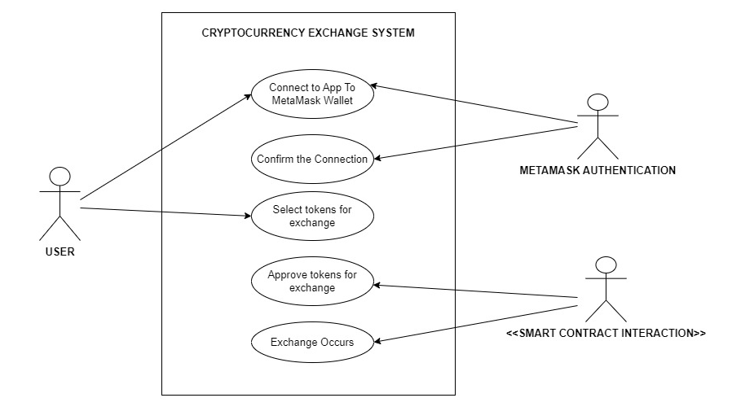
USE CASE DIAGRAM

Slide 16
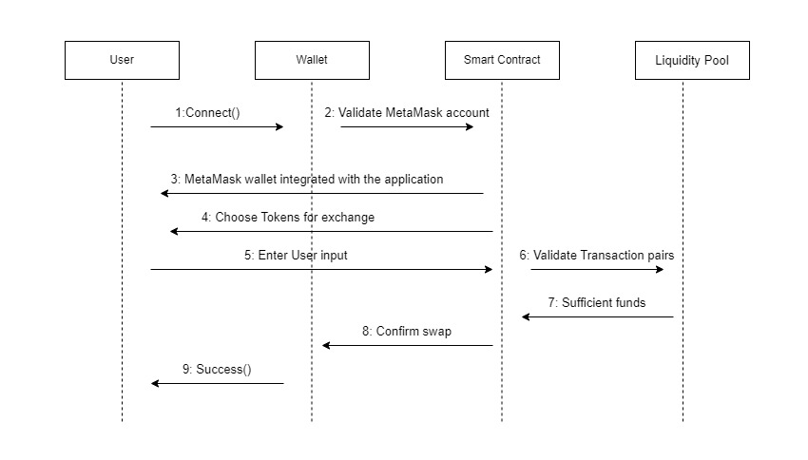
SEQUENCE DIAGRAM

Slide 17
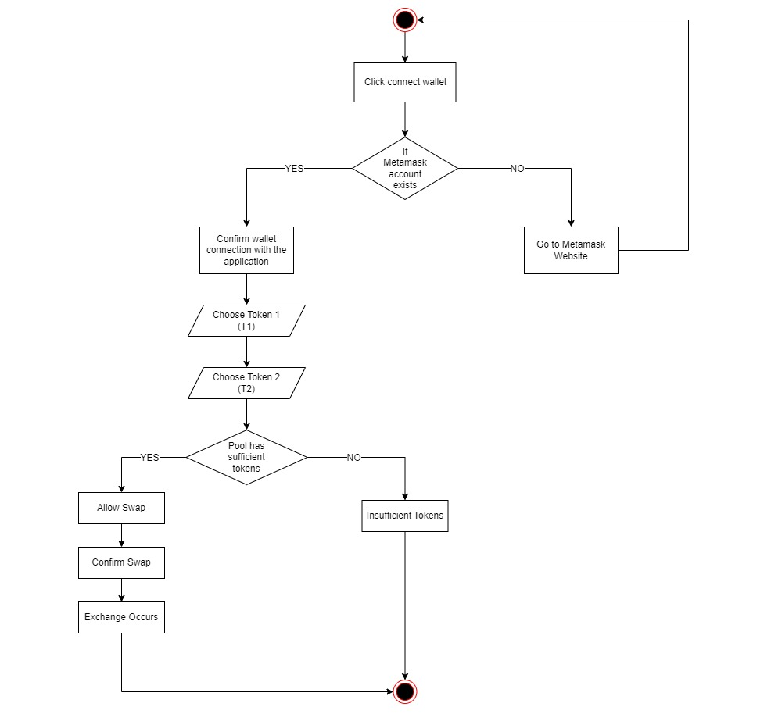
ACTIVITY DIAGRAM

Slide 18
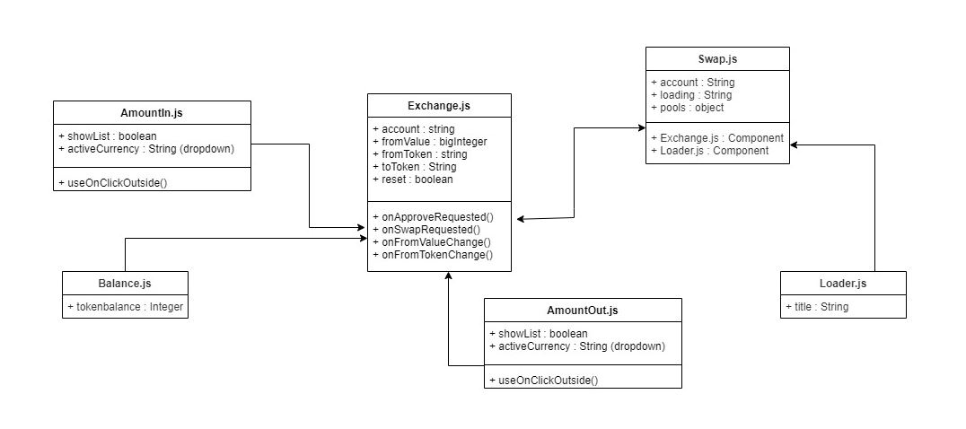
CLASS DIAGRAM

Slide 19
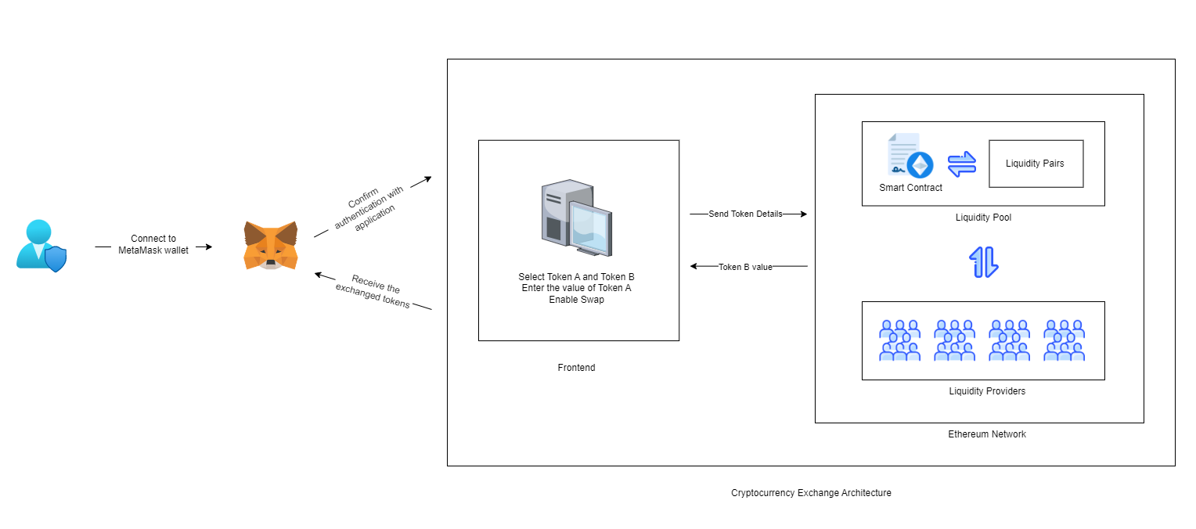
ARCHITECTURE DIAGRAM

Slide 20
IMPLEMENTATION

Slide 21
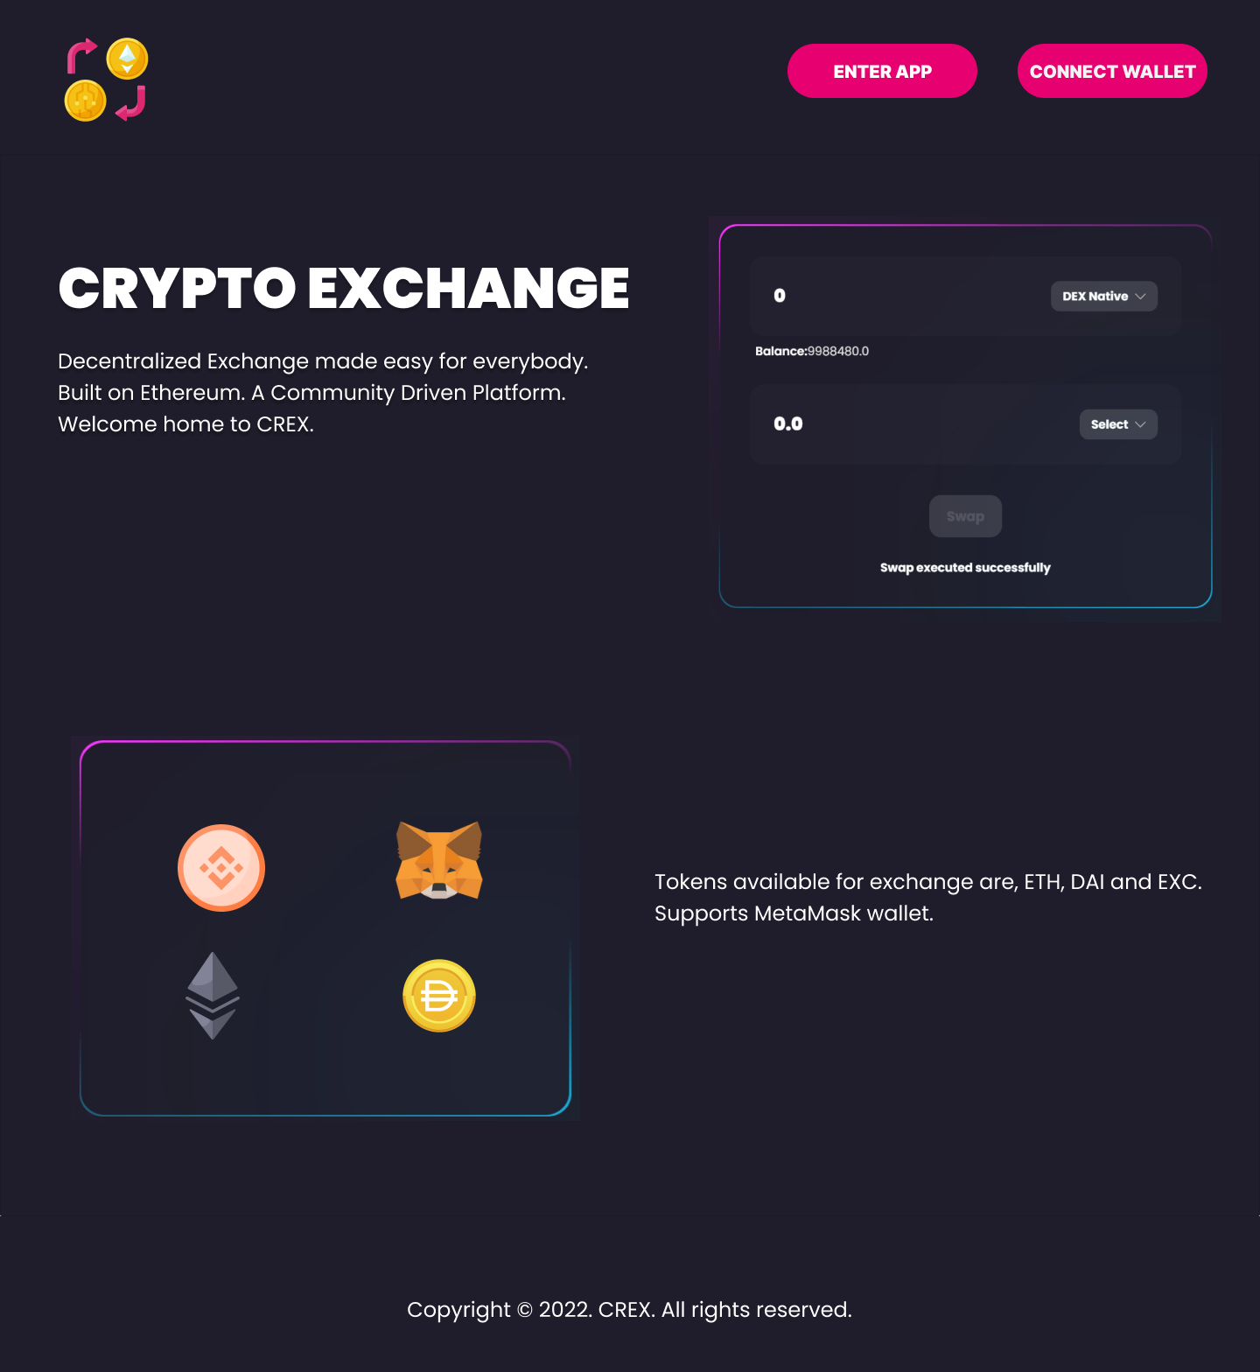

Slide 22
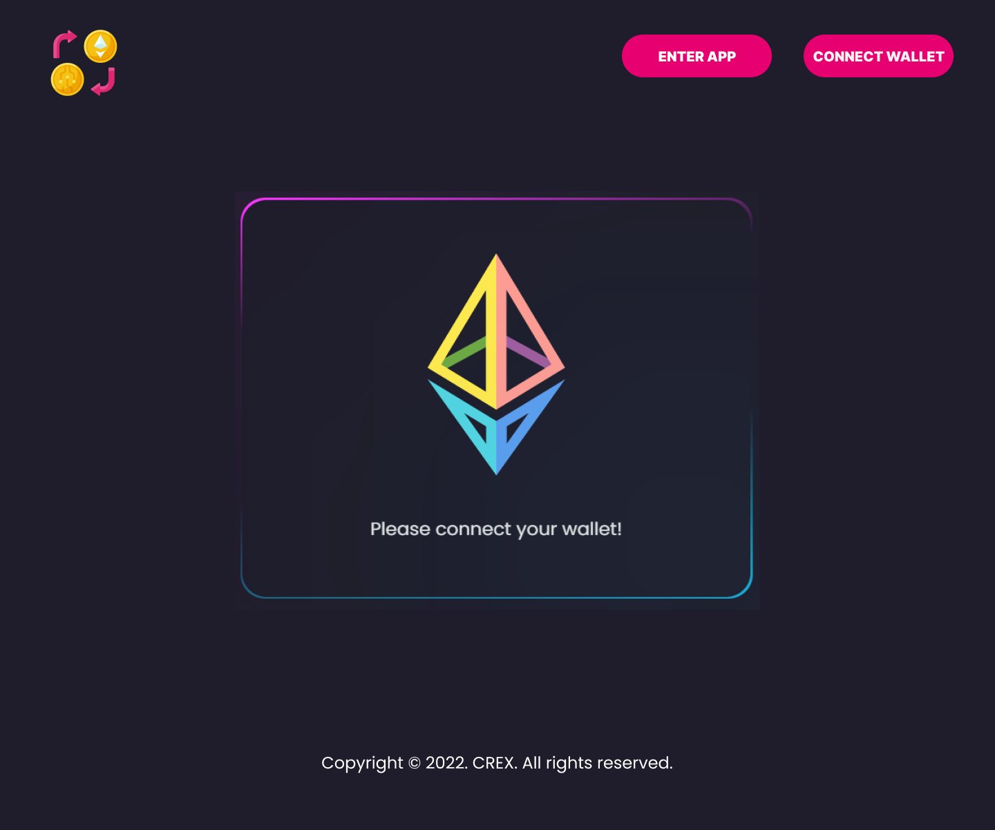
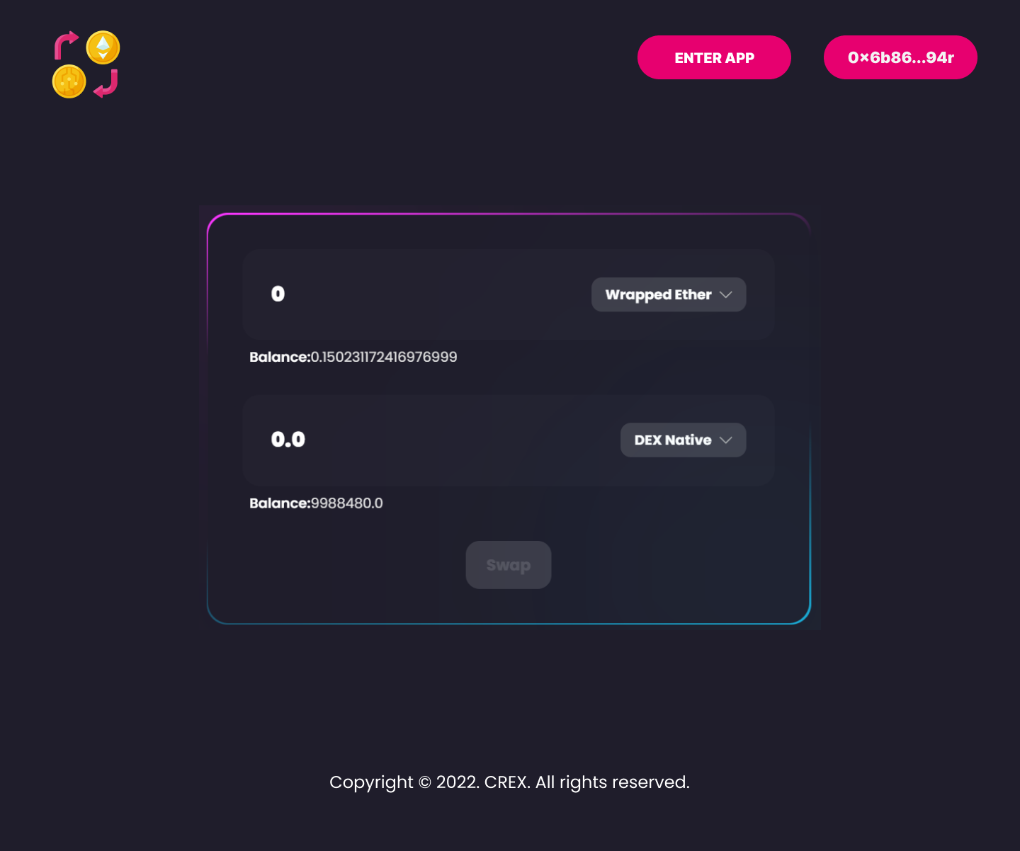

Slide 23
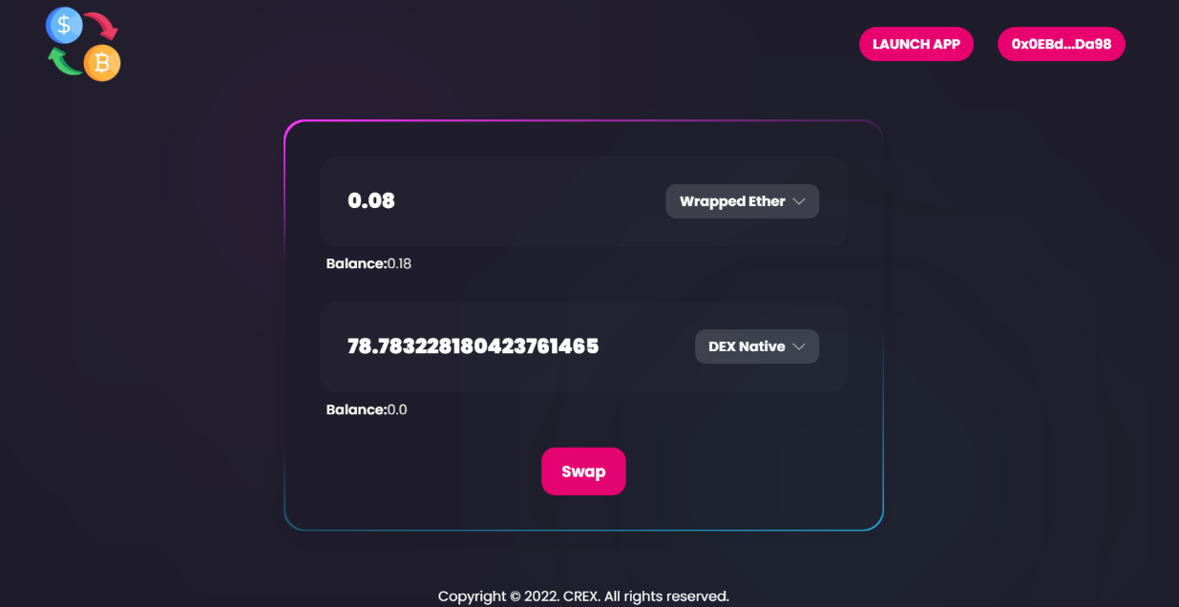
AmountIn.js
It is an input box for the user to enter the amount to be swapped
It also contains a drop down with a list of all the tokens that the user can select.
It consists of list of tokens. SetShowList is responsible for changing the state of token.

Slide 24
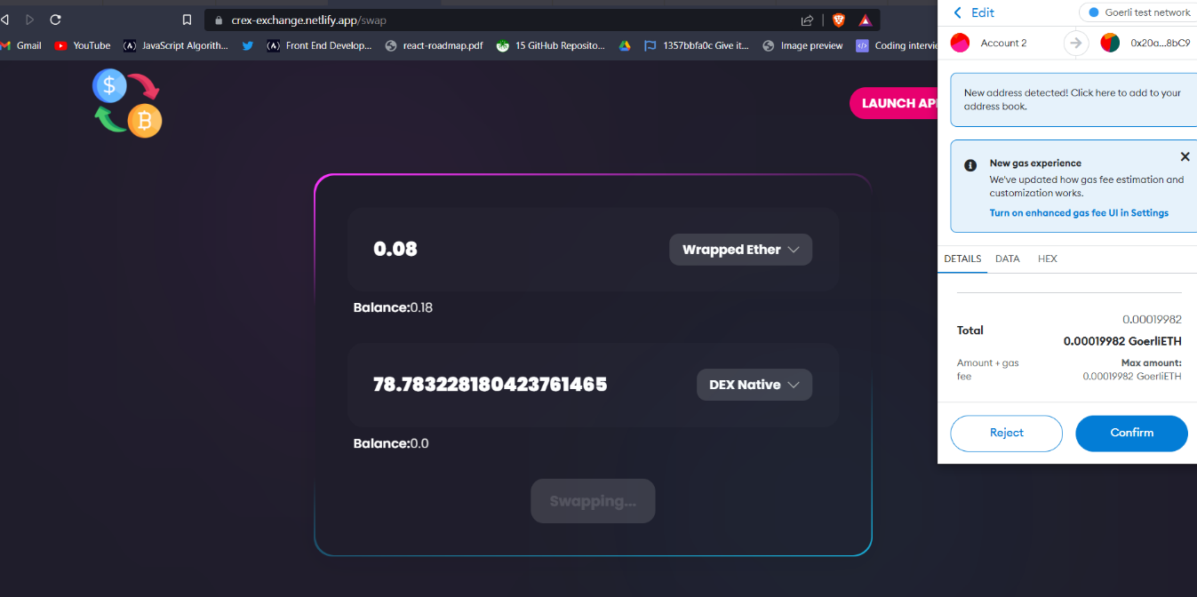
Exchange.js
It is used to carry out the exchanges of the various cryptocurrencies
Methods used in exchange.js are onApproveRequested, onSwapRequested, OnFromValueChange, onFromTokenChange.
OnFromValueChange, onFromTokenChange methods are used when there are changes made in the input block and tokens respectively.

Slide 25
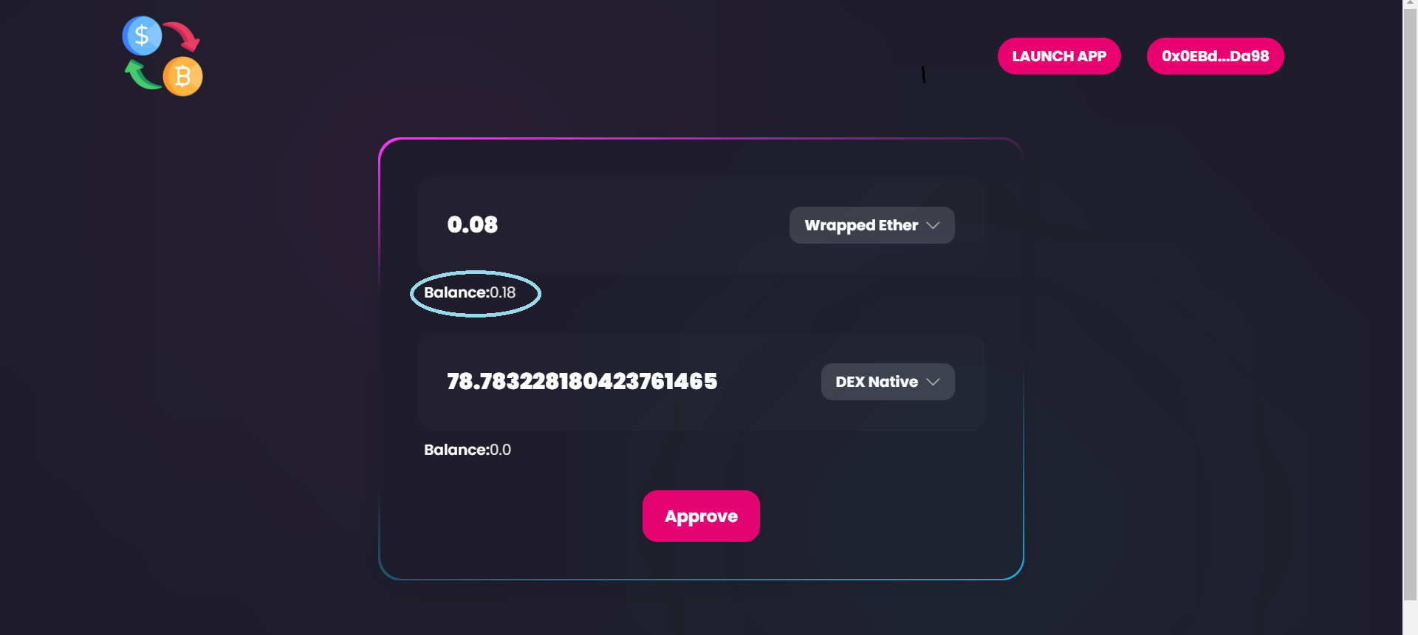
Balance.js
Displays the token balance of the user in the MetaMask Wallet.
If there is no balance, 0 is displayed.
The format units expects a value always, so the parseUnits should pass 0, parseUnits converts from string to integer/bigInt

Slide 26
APPLICATION URL
https://crex-exchange.netlify.app/

Slide 27
Test cases

Slide 28
Launching Home Page
Test Scenario ID |  | Home Page |  |  | Test Case ID |  | Home Page
Test Case Description |  | Launching Home Page |  |  | Test Priority |  | High
Pre-Requisite |  | NA |  |  | Post Requisite |  | NA
Test Execution Steps :
No | Action | Inputs | Inputs | Expected Output | Actual Output | Test Browser | Test Result | Test Comments
1 | Open Home Page | https://crex-exchange.netlify.app/ | https://crex-exchange.netlify.app/ | Open Home Page on using the URL | Open Home Page on using the URL | Brave | Pass | NA

Slide 29
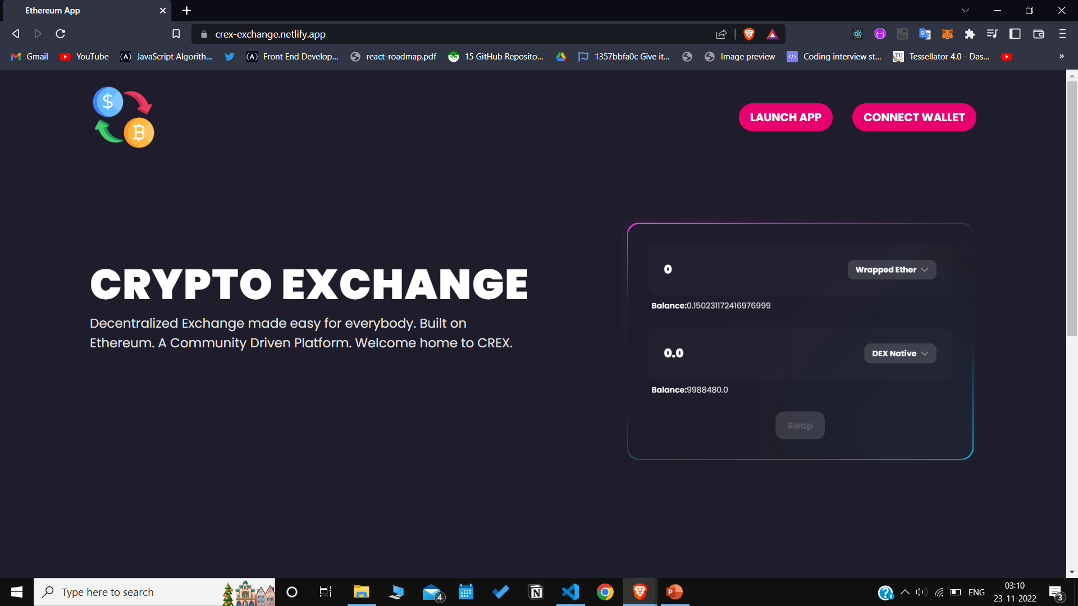
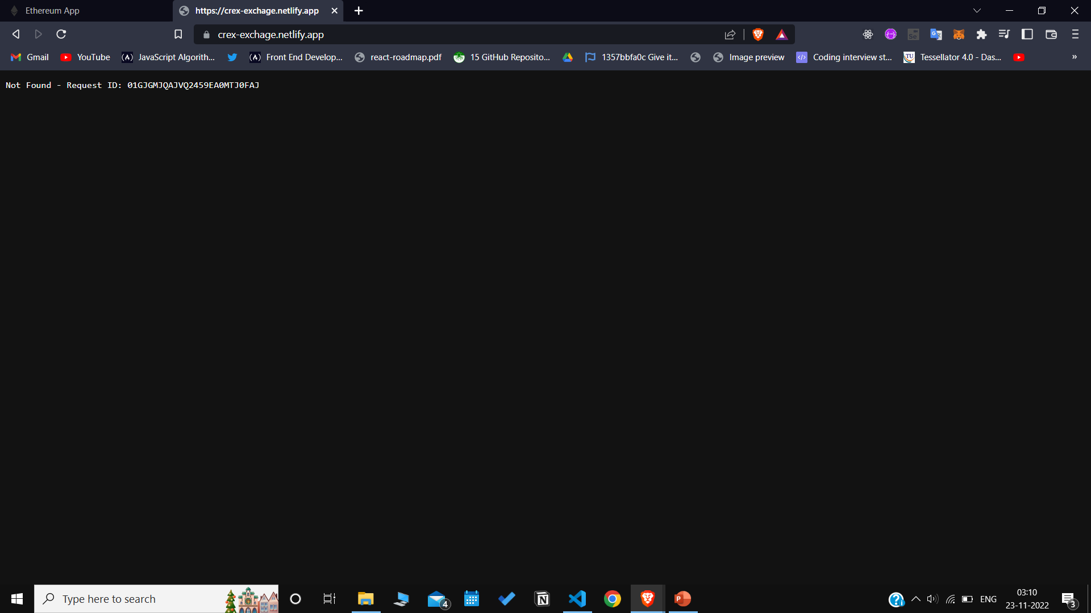
SUCCESS CASE
FAILURE CASE

Slide 30
Launching Exchange App Page
Test Scenario ID |  | Swap Page |  |  | Test Case ID |  | Swap Page
Test Case Description |  | Launching Exchange Page |  |  | Test Priority |  | High
Pre-Requisite |  | NA |  |  | Post Requisite |  | NA
Test Execution Steps :
No | Action | Inputs | Inputs | Expected Output | Actual Output | Test Browser | Test Result | Test Comments
1 | Open Swap Page | https://crex-exchange.netlify.app/swap | https://crex-exchange.netlify.app/swap | Open Swap Page on Clicking the Launch Button | Open Swap Page on Clicking the Launch Button | Brave | Pass | NA

Slide 31
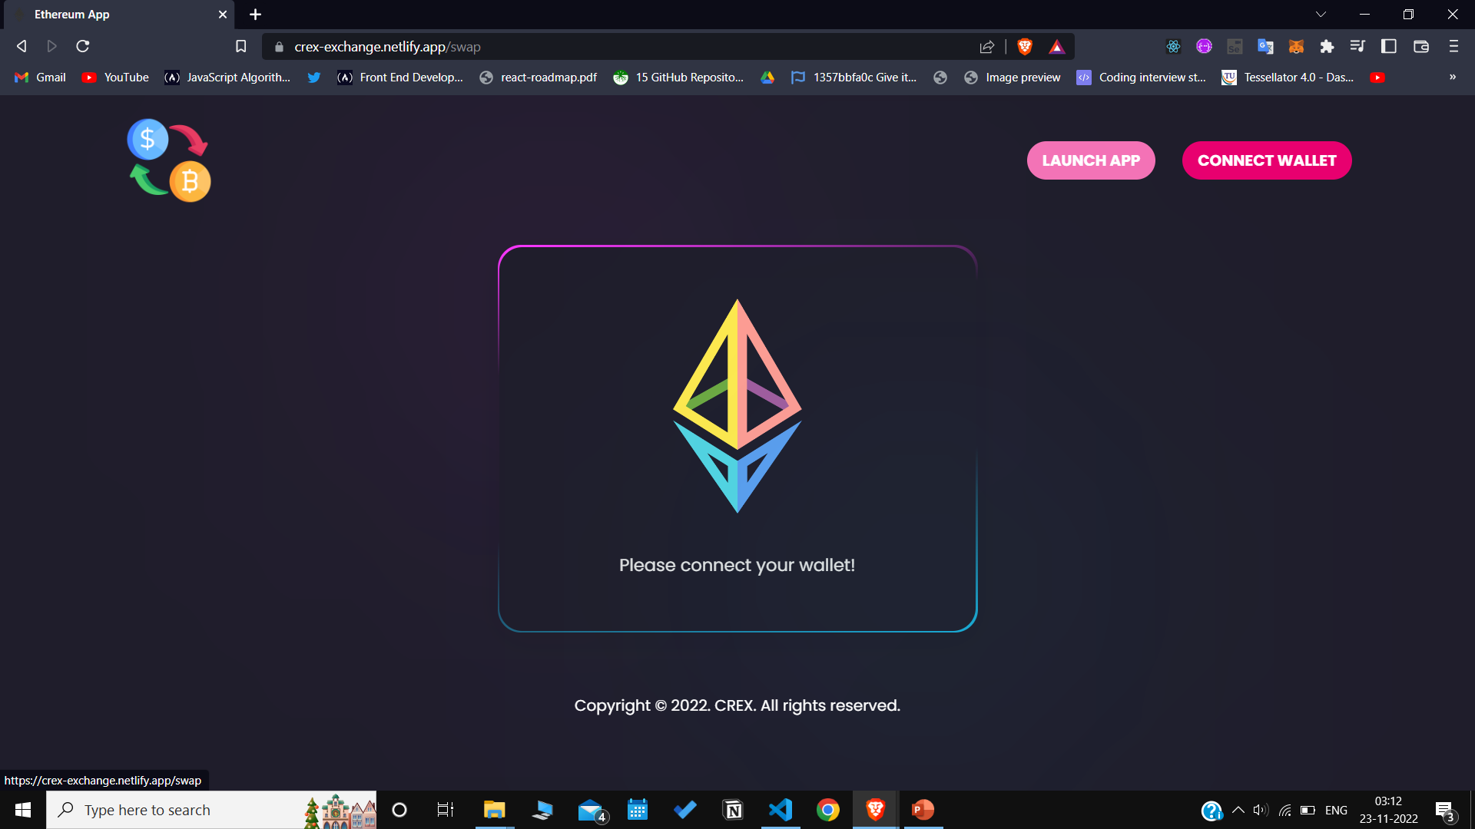
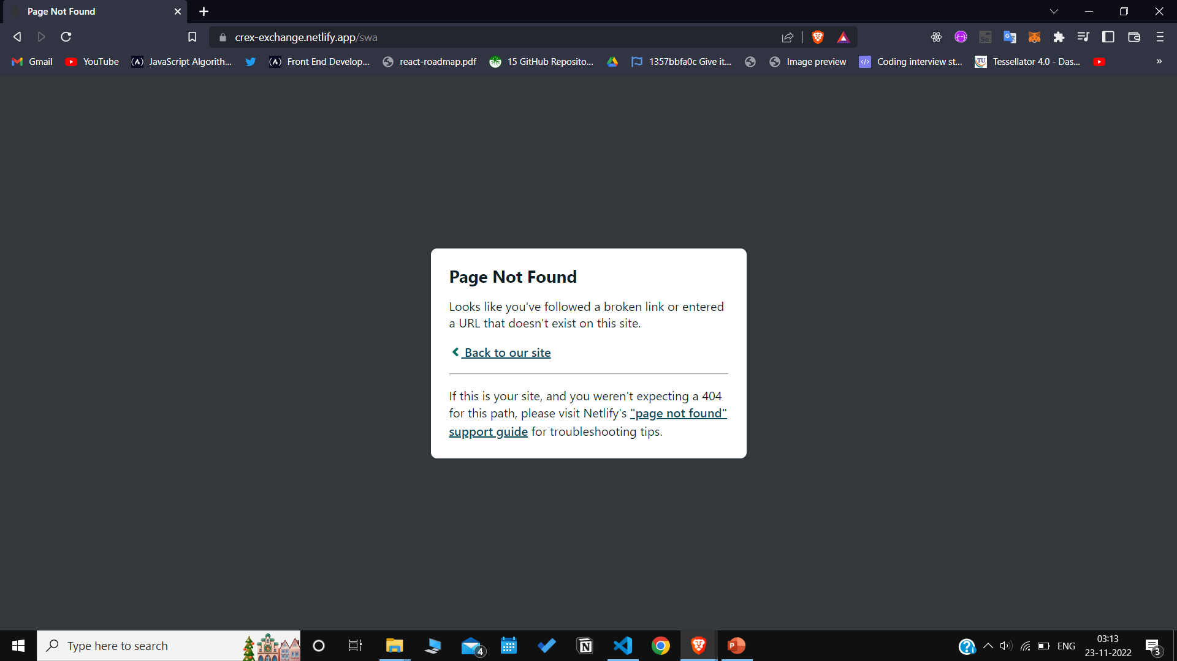
SUCCESS CASE
FAILURE CASE

Slide 32
Connect MetaMask Wallet
Test Scenario ID |  | Connect MetaMask Wallet |  |  | Test Case ID |  | Connect Wallet
Test Case Description |  | Connecting MetaMask Wallet with Application |  |  | Test Priority |  | High
Pre-Requisite |  | NA |  |  | Post Requisite |  | NA
Test Execution Steps :
No | Action | Inputs | Inputs | Expected Output | Actual Output | Test Browser | Test Result | Test Comments
1 | Connect wallet | https://crex-exchange.netlify.app/swap | https://crex-exchange.netlify.app/swap | Wallet Connected Successfully | Wallet Connected Successfully | Brave | Pass | NA

Slide 33
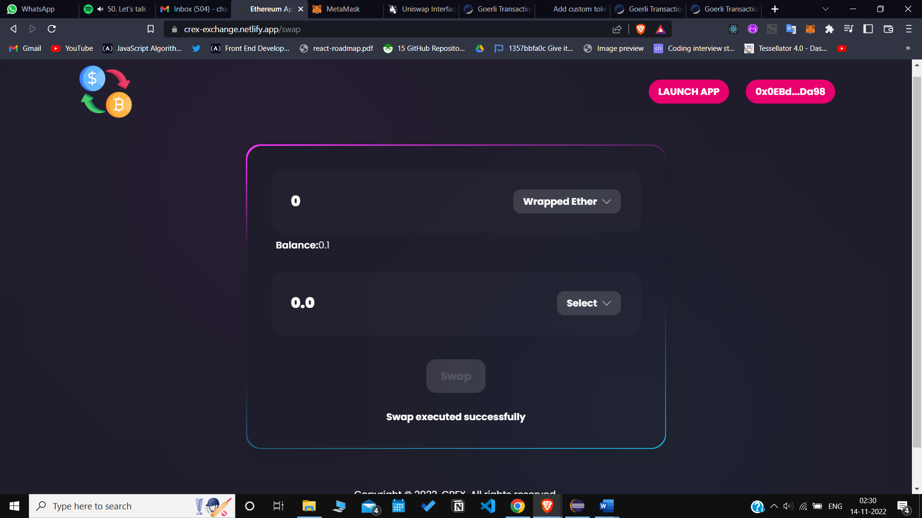
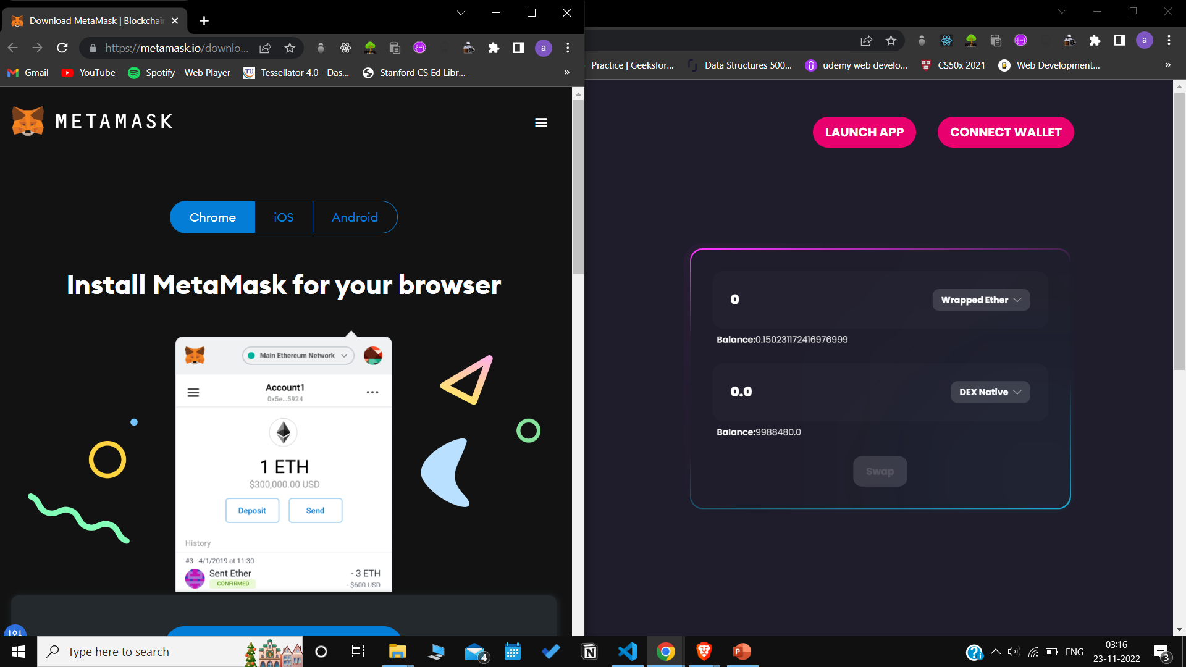
SUCCESS CASE
FAILURE CASE

Slide 34
Currency to be Exchanged
Test Scenario ID |  | Exchange |  | Test Case ID |  | Exchange
Test Case Description |  | Enter currency to be exchanged |  | Test Priority |  | High
Pre-Requisite |  | NA |  | Post Requisite |  | NA
Test Execution Steps :
No | Action | Inputs | Expected Output | Actual Output | Test Browser | Test Result | Test Comments
1 | Perform Exchange Action | https://crex-exchange.netlify.app/swap | Select the token, and enter amount to be exchanged | Select the token, and enter amount to be exchanged | Brave | Pass | NA

Slide 35

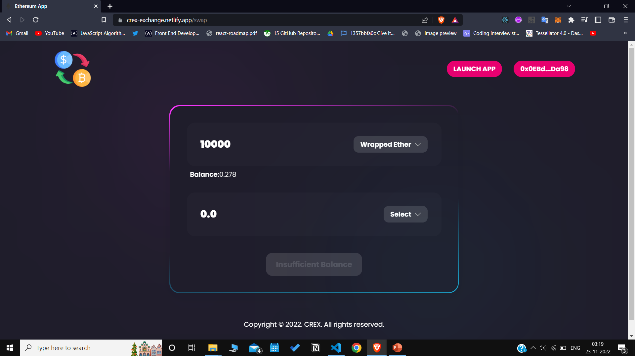
SUCCESS CASE
FAILURE CASE

Slide 36
RESOURCES
[1] Robin Fritsch. 2021. Concentrated Liquidity in Automated Market Makers. In Proceedings of the 2021 ACM CCS Workshop on Decentralized Finance and Security (DeFi@CCS), Virtual Event, Republic of Korea.
[2] Lioba Heimbach, Ye Wang, and Roger Wattenhofer. 2021. Behavior of Liquidity Providers in Decentralized Exchanges. In 2021 Crypto Valley Conference on Blockchain Technology (CVCBT), Rotkreuz, Switzerland.
[3] S. Wang, Y. Yuan, X. Wang, J. Li, R. Qin and F. -Y. Wang, "An Overview of Smart Contract: Architecture, Applications, and Future Trends," 2018 IEEE Intelligent Vehicles Symposium (IV), 2018, pp. 108-113, doi: 10.1109/IVS.2018.8500488.
[4] Yao, M., Di, H., Zheng, X. and Xu, X., 2018. Impact of payment technology innovations on the traditional financial industry: A focus on China. Technological Forecasting and Social Change, 135, pp.199-207.
[5] Böhme, Rainer, Nicolas Christin, Benjamin Edelman, and Tyler Moore. "Bitcoin: Economics, technology, and governance." Journal of economic Perspectives 29, no. 2 (2015): 213-38.
[6] Dannen, C. (2017). Introducing Ethereum and solidity (Vol. 1, pp. 159-160). Berkeley: Apress.
[7] Wu, Kaidong. "An empirical study of blockchain-based decentralized applications." arXiv preprint arXiv:1902.04969 (2019).

Slide 37
RESOURCES
[8] Somin, Shahar, Goren Gordon, and Yaniv Altshuler. "Network analysis of erc20 tokens trading on ethereum blockchain." In International Conference on Complex Systems, pp. 439-450. Springer, Cham, 2018.
[9] Chen, Yan, Jack I. Richter, and Pankaj C. Patel. "Decentralized governance of digital platforms." Journal of Management 47, no. 5 (2021): 1305-1337.
[10] Bartoletti, M., Chiang, J. H. Y., & Lluch-Lafuente, A. (2021, June). A theory of automated market makers in defi. In International Conference on Coordination Languages and Models (pp. 168-187). Springer, Cham.

Slide 38
THANK YOU

